Slide 1
Generalized linear models and logistic regression
Arunabh singh W5D2 Sep Cohort LHL

Slide 2
Linear regression assumptions
We know that Linear Regression models Linear relationship between X and Y.
y=β0+β1x1+…+βpxp+ϵ
linear regression model assumes that the outcome y of an instance can be expressed by a weighted sum of its p features with an individual error E that follows a Gaussian distribution.
a simple weighted sum is too restrictive for many real world prediction problems.
But a simple weighted sum is too restrictive for many real world prediction problems.

Slide 3
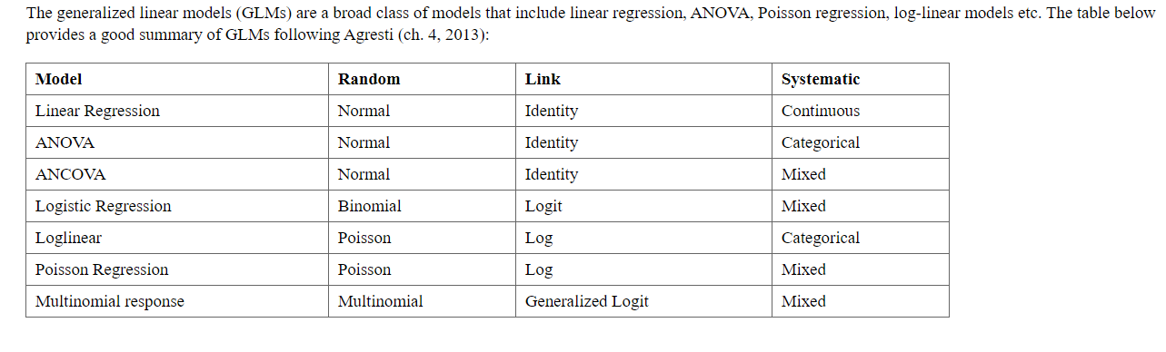
Generalized Linear models
They use a link function to model non continuous systematic or Random Variables or basically X and y.
This is a family of models which are similar to each other and include the Linear Regression in it.
GLMs are very useful as they model properties and relationships not usually not captured by Linear Regression.

Slide 4
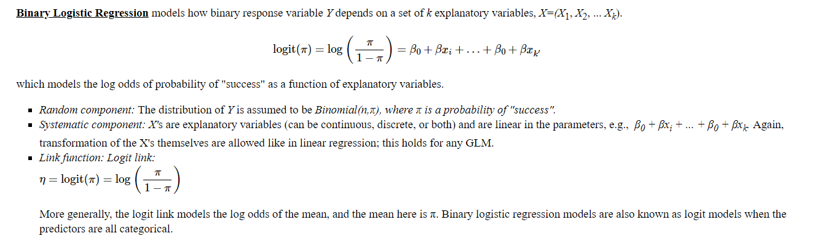
Binary Logistic Regression

Slide 5
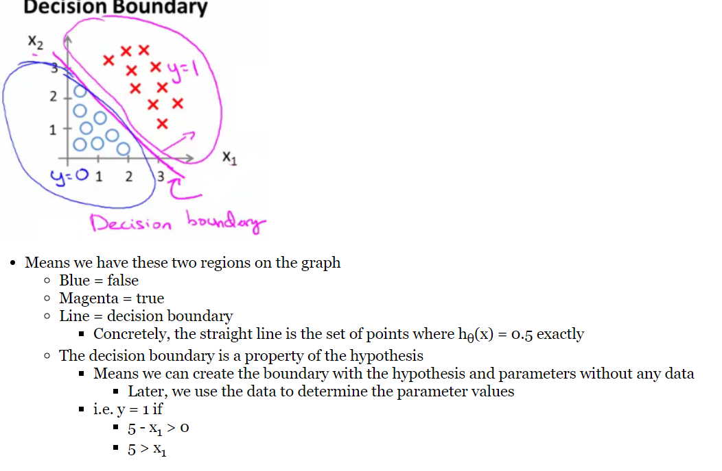
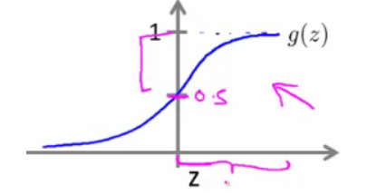
Logistic Regression Properties
P>0.5 represents class 1
P<0.5 represents class 0
Sigmoid Function

Slide 6
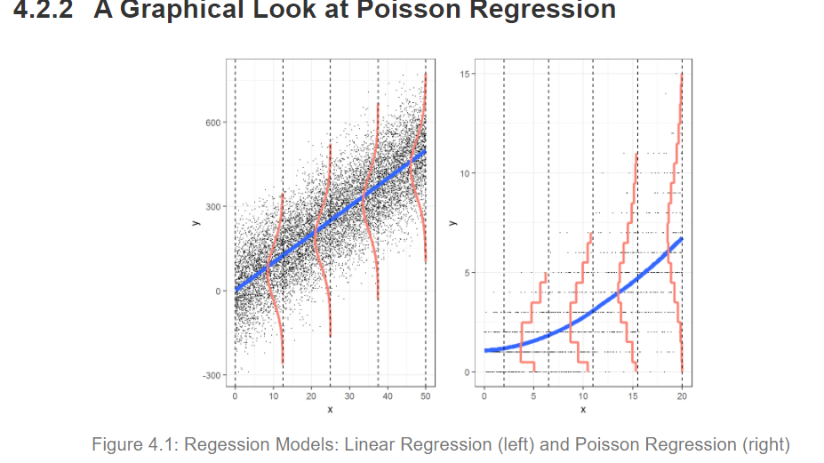
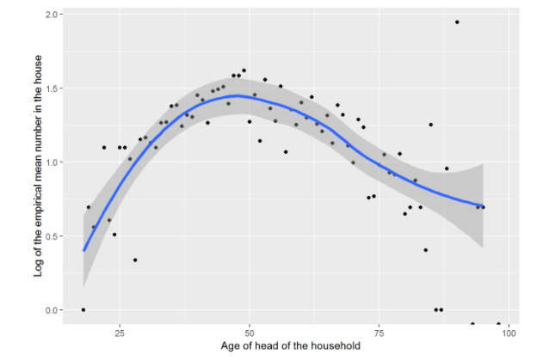
Poisson regression
Model used in poisson regression is log(lambda1) = beta0 + Beta1x
Response variable follows poisson distribution
Log(lambda) must be a linear function of x.
Source: https://bookdown.org/roback/bookdown-bysh/ch-poissonreg.html

Slide 7
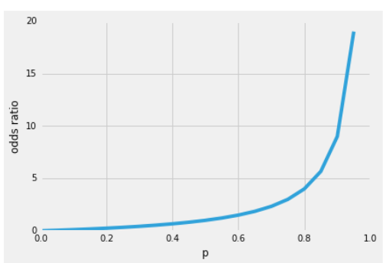
ODDS ratio
Let’s start with the so-called “odds ratio” p / (1 - p), which describes the ratio between the probability that a certain, positive, event occurs and the probability that it doesn’t occur – where positive refers to the “event that we want to predict”, i.e., p(y=1 | x)
So, the more likely it is that the positive event occurs, the larger the odds’ ratio
Source: https://sebastianraschka.com/faq/docs/logistic-why-sigmoid.html

Slide 8


LOG-ODDS ratio
Now, if we take the natural log of this odds’ ratio, the log-odds or logit function, we get the following
Next, let’s use this log transformation to model the relationship between our explanatory variables and the target variable.
Source: https://sebastianraschka.com/faq/docs/logistic-why-sigmoid.html

Slide 9
SIGMOID FUNCTION

Slide 10
THE END

